Slide 1
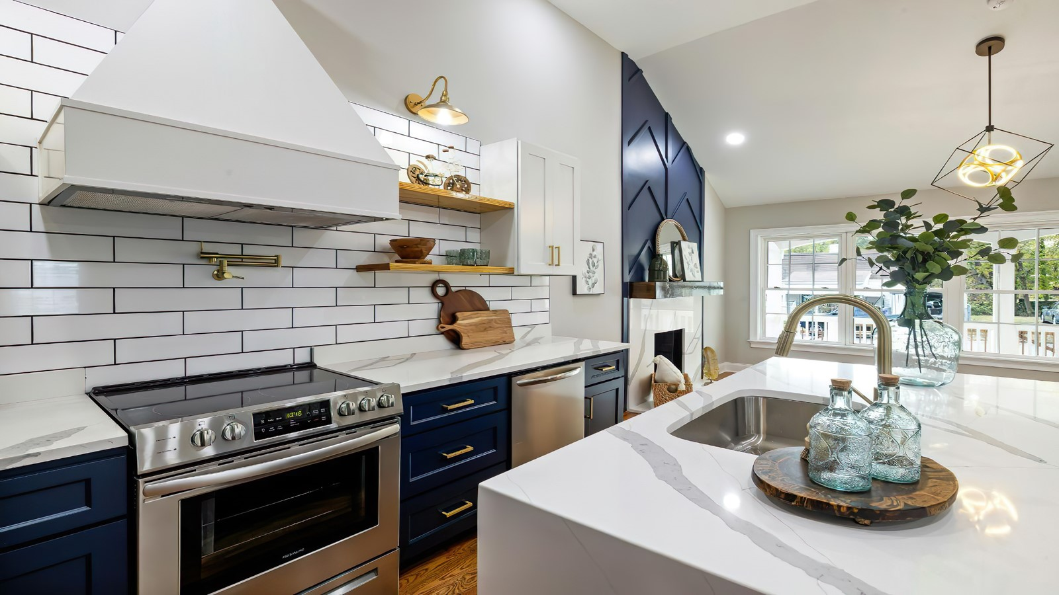



Smart Kitchen
&
Alarm System
Head Chef:
Ehatasham Haque
Under-Chef:
Tawhid Janan Avik
Station Chef:
Hasibul Hasan
Pantry Chef:
Sunjana Tarannum

Slide 2
Head Chef:
Ehatasham Haque
Under-Chef:
Tawhid Janan Avik
Smart Kitchen
Station Chef:
Hasibul Hasan
&
Pantry Chef:
Sunjana Tarannum
Alarm System

Slide 3




INDRODUCTION
Food is the lifeblood for a robust health, but it shouldn't consume all our time.
Consider how much you could be doing instead of cleaning your own mess.
Smart kitchens lead to smarter cooking and better awareness.
So, a smart kitchen and alarm system is the way of the future.

Slide 4


M O T I V A T I O N

Slide 5

Progenitors
Focus on a single issue.
At average two sensors.
Focus on only monitoring or alarm or automation.
The Progeny
Focus on a multitude of issues.
At average 4 sensors.
Equal focus on monitoring & alarm, minimal automation.

Slide 6
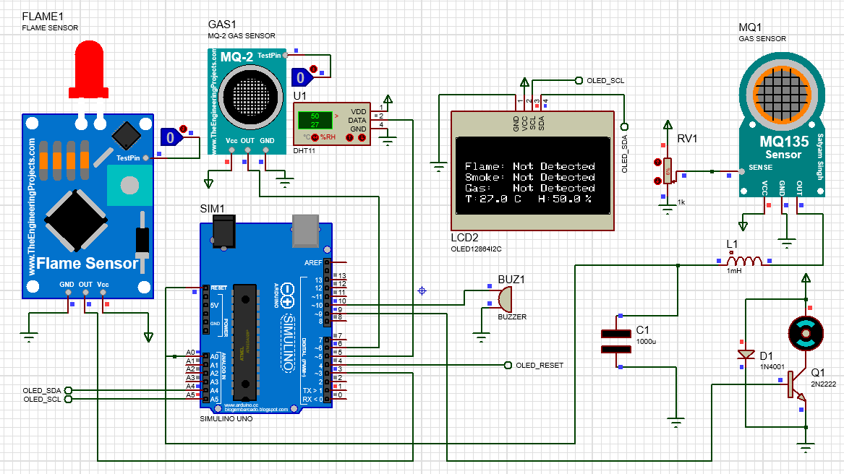
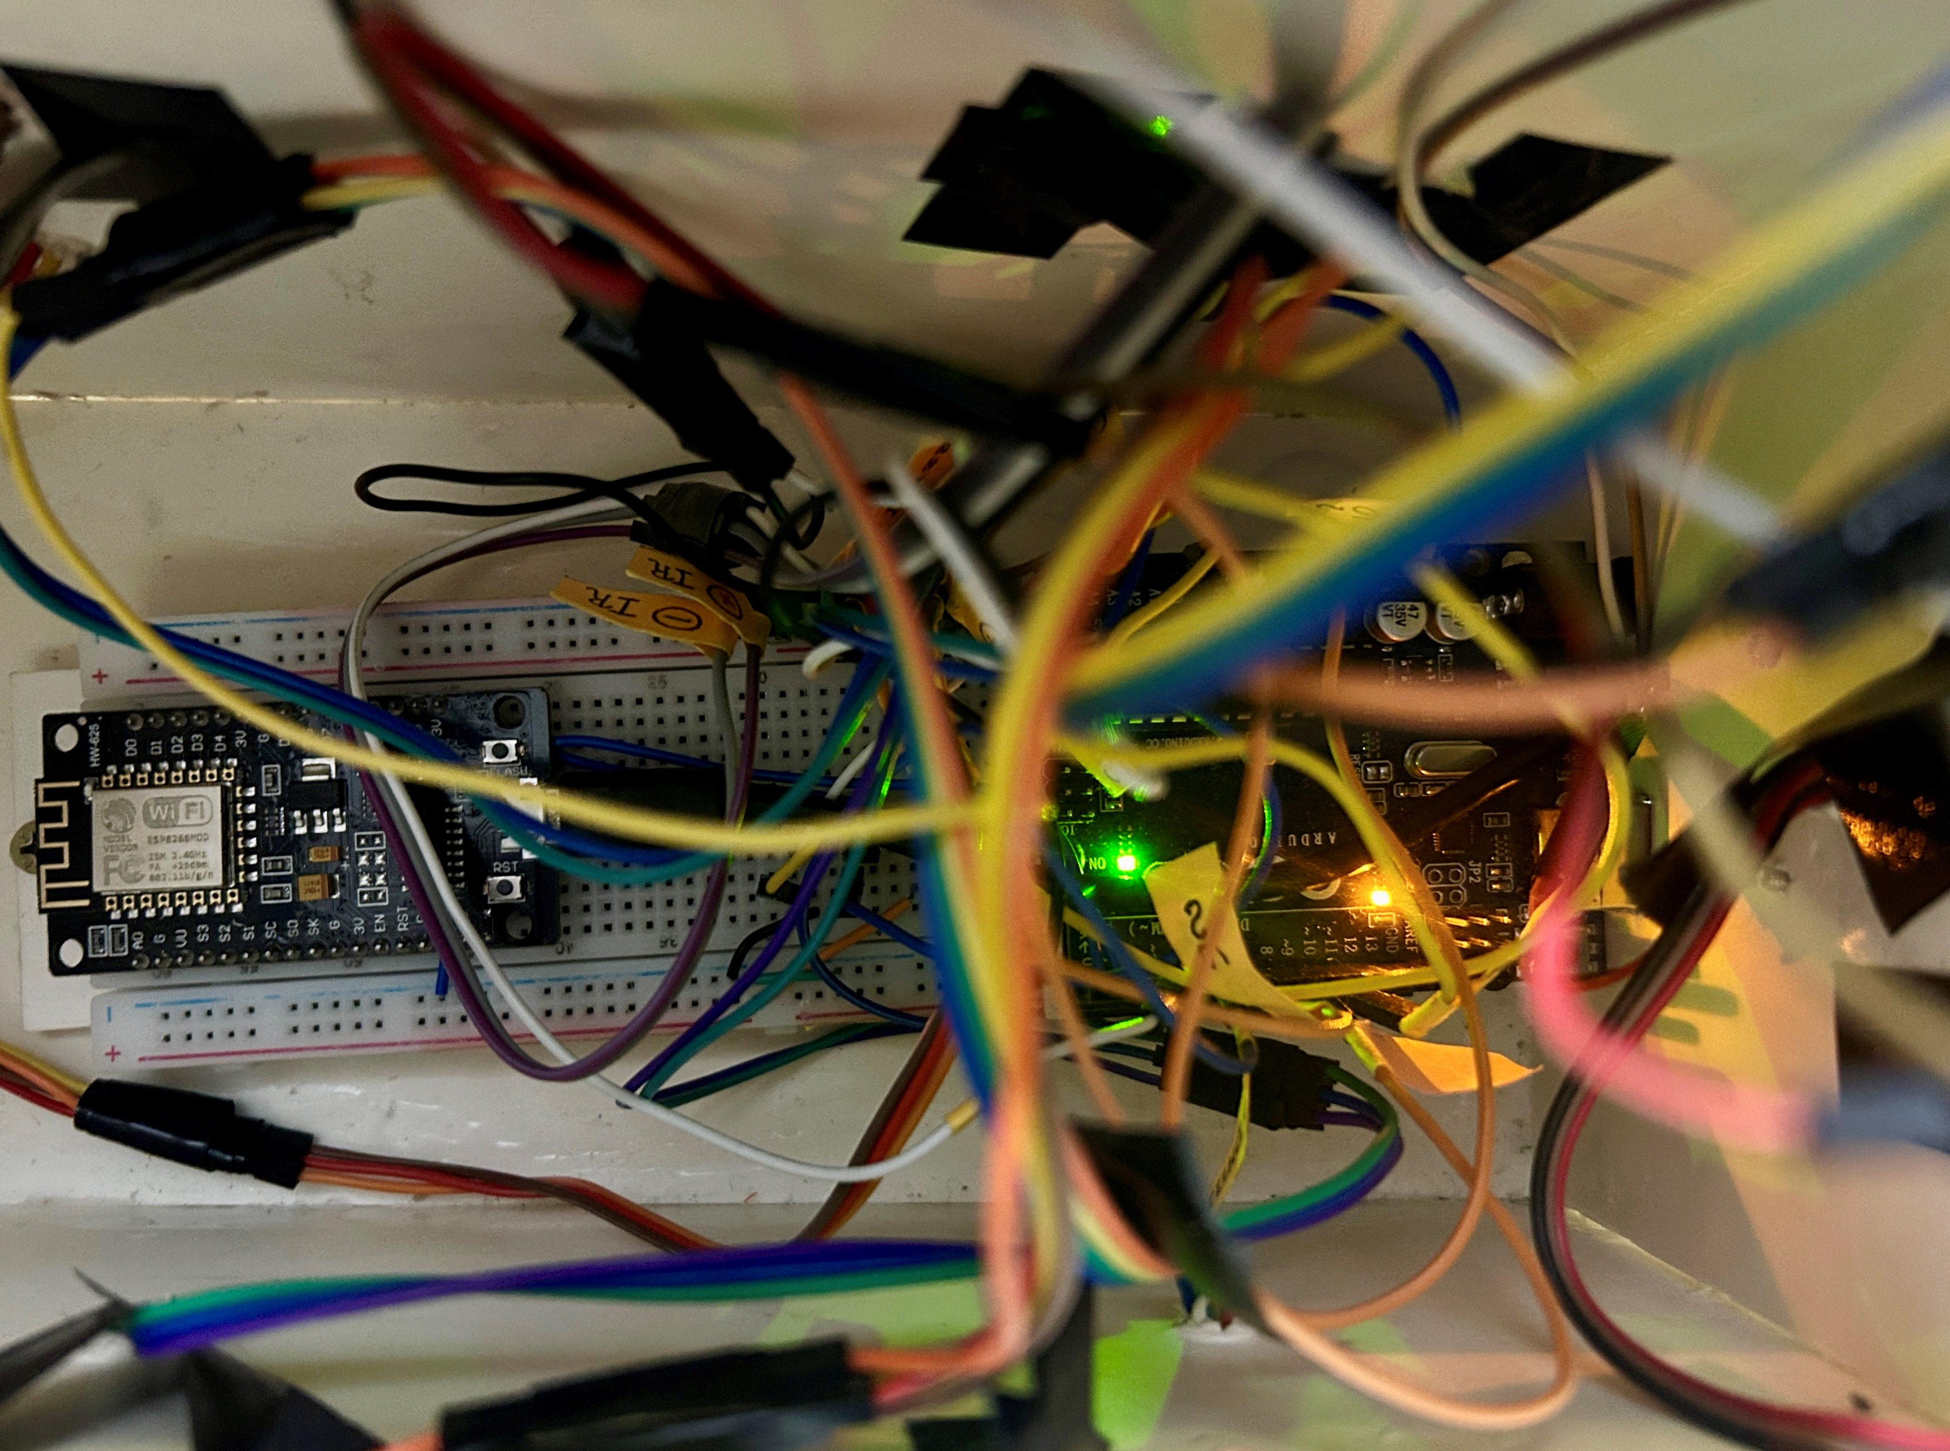
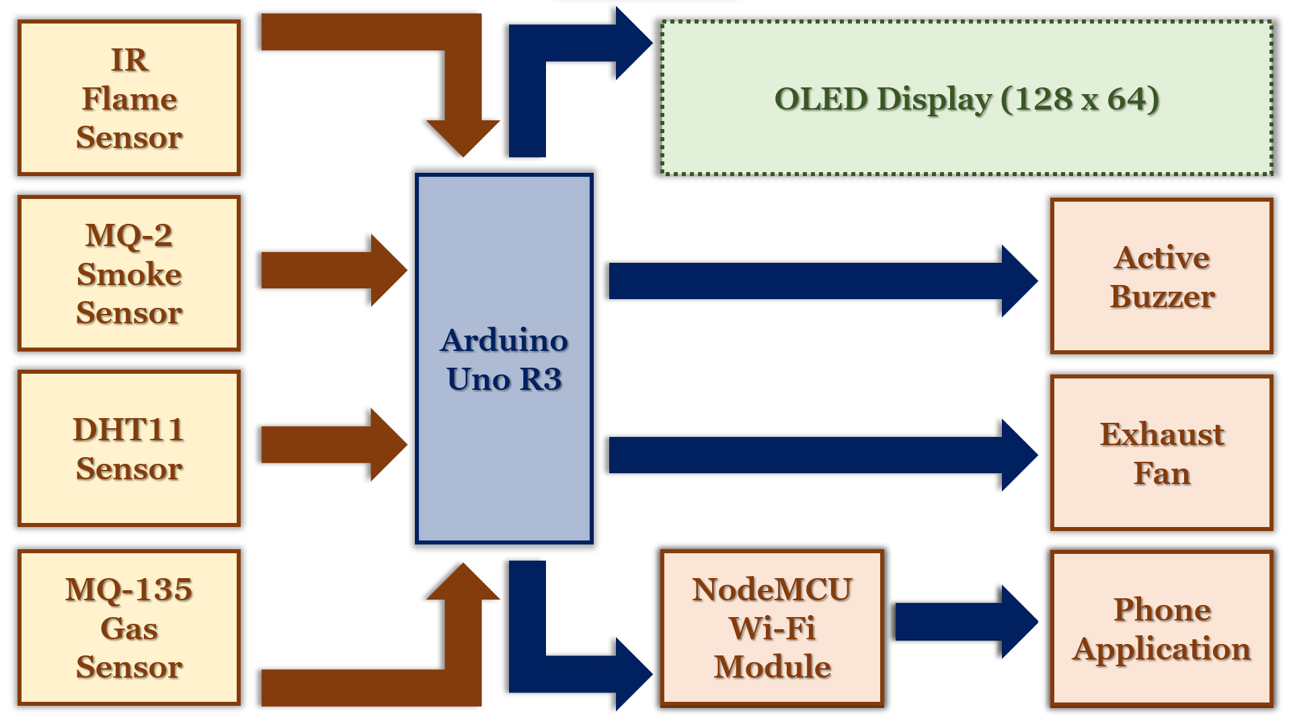

Method to Madness
BLOCK DIAGRAM
CIRCUIT DIAGRAM
HARDWARE

Slide 7
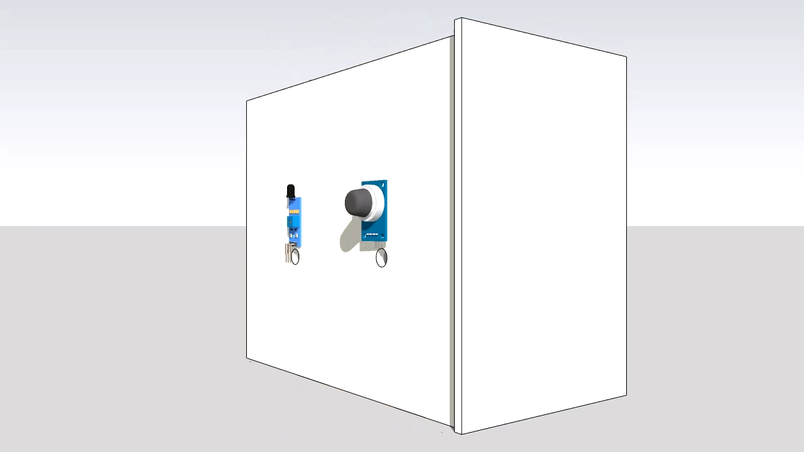
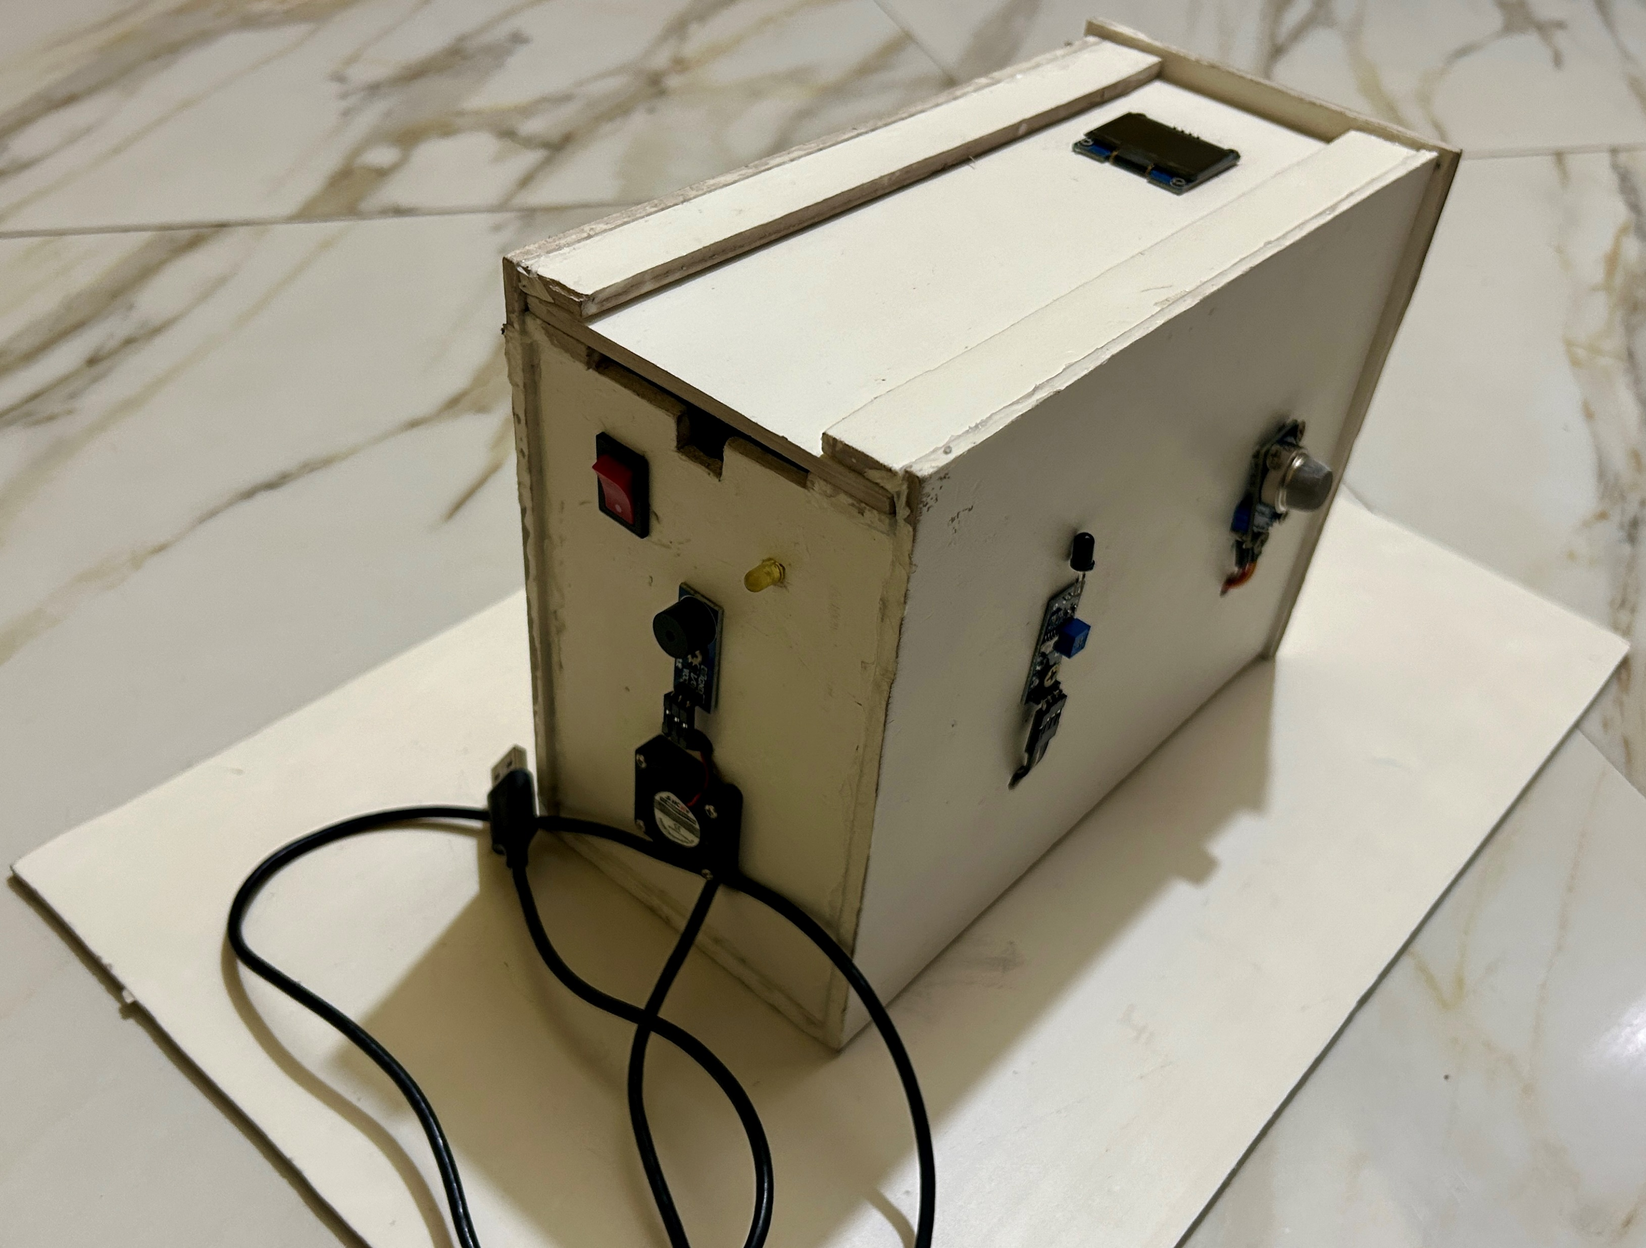
Casing the Madness

Slide 8
Read:
Flame Sensor,
Smoke Sensor,
DHT11 Sensor,
Gas Sensor.
Start.
NO
Sound an Alarm.
YES
Is Flame present?
YES
Display,
‘Detected’.
NO
Sound an Alarm.
YES
Is Smoke Present?
YES
Display,
‘Detected’.
CODE
FLOWCHART
NO
YES
Is Gas Present?
YES
Display,
‘Detected’.
End.
NO
Turn an Exhaust Fan.
YES
Is
Humidity
> 60% ?
Display,
‘Detected’.
YES
NO

Slide 9
Set
A
Set
B
Set
C
Set
D
void handleAlarms(int Flame_Value, int Smoke_Value, int Gas_Value) {
if (Gas_Value == LOW) {
tone(Buzzer_Pin, 2280);
digitalWrite(Exhaust_Fan_Pin, HIGH);
}
else if (Flame_Value == LOW) {
tone(Buzzer_Pin, 1520);
}
else if (Smoke_Value == LOW) {
tone(Buzzer_Pin, 760);
}
else {
noTone(Buzzer_Pin);
digitalWrite(Exhaust_Fan_Pin, LOW);
}
digitalWrite(Exhaust_Fan_Pin, DHT.humidity > Humidity_Threshold ? HIGH : LOW);
}
void loop() {
int Flame_Value = digitalRead(Flame_Sensor_Pin);
int Smoke_Value = digitalRead(Smoke_Sensor_Pin);
int Gas_Value = digitalRead(Gas_Sensor_Pin);
DHT.read11(Dht_Pin);
StaticJsonDocument<200> doc;
doc["Flame"] = (Flame_Value == LOW) ? "Detected" : "Not Detected";
doc["Smoke"] = (Smoke_Value == LOW) ? "Detected" : "Not Detected";
doc["Gas"] = (Gas_Value == LOW) ? "Detected" : "Not Detected";
doc["Temperature"] = DHT.temperature;
doc["Humidity"] = DHT.humidity;
String jsonString;
serializeJson(doc, jsonString);
Serial.println(jsonString);
delay(1000);
displayData(Flame_Value, Gas_Value, Smoke_Value);
handleAlarms(Flame_Value, Smoke_Value, Gas_Value);
}
#include <U8glib.h>
#include <dht.h>
#include <ArduinoJson.h>
const int Flame_Sensor_Pin = 3;
const int Smoke_Sensor_Pin = 6;
const int Gas_Sensor_Pin = 11;
const int Buzzer_Pin = 10;
const int Dht_Pin = 5;
const int Exhaust_Fan_Pin = 9;
const int Humidity_Threshold = 60;
U8GLIB_SH1106_128X64 u8g(U8G_I2C_OPT_NONE);
dht DHT;
void setup() {
Serial.begin(9600);
pinMode(Flame_Sensor_Pin, INPUT);
pinMode(Smoke_Sensor_Pin, INPUT);
pinMode(Gas_Sensor_Pin, INPUT);
pinMode(Buzzer_Pin, OUTPUT);
pinMode(Exhaust_Fan_Pin, OUTPUT);
}
void displayData(int Flame_Value, int Gas_Value, int Smoke_Value) {
u8g.firstPage();
do {
u8g.setFont(u8g_font_unifont);
u8g.setFont(u8g_font_6x10);
u8g.drawStr(7, 15, "Flame: ");
u8g.drawStr(50, 15, Flame_Value == LOW ? "Detected" : "Not Detected");
u8g.drawStr(7, 45, "Gas: ");
u8g.drawStr(50, 45, Gas_Value == LOW? "Detected" : "Not Detected");
u8g.drawStr(7, 30, "Smoke: ");
u8g.drawStr(50, 30, Smoke_Value == LOW ? "Detected" : "Not Detected");
u8g.drawStr(10, 60, "T: ");
u8g.drawStr(25, 60, String(DHT.temperature, 1).c_str());
u8g.drawStr(50, 60, "C");
u8g.drawStr(70, 60, "H: ");
u8g.drawStr(85, 60, String(DHT.humidity, 1).c_str());
u8g.drawStr(110, 60, "%");
} while (u8g.nextPage());
}
ARDUINO
CODE

Slide 10
Set
A
Set
B
Set
C
Set
D
void setup() {
Serial.begin(9600);
Blynk.begin(auth, ssid, pass);
Serial.println("Connecting to WiFi...");
while (WiFi.status() != WL_CONNECTED) {
delay(500);
Serial.print(".");
}
Serial.println("");
Serial.println("WiFi connected");
Serial.print("IP address: ");
Serial.println(WiFi.localIP());
}
Blynk.virtualWrite(FLAME_PIN, doc["Flame"].as<String>());
Blynk.virtualWrite(SMOKE_PIN, doc["Smoke"].as<String>());
Blynk.virtualWrite(GAS_PIN, doc["Gas"].as<String>());
Blynk.virtualWrite(TEMP_PIN, doc["Temperature"].as<float>());
Blynk.virtualWrite(HUMIDITY_PIN, doc["Humidity"].as<float>());
}
void loop() {
Blynk.run();
if (Serial.available() > 0) {
String data = Serial.readStringUntil('\n');
parseSensorData(data);
}
}
void parseSensorData(String data) {
Serial.println("Received data: " + data);
StaticJsonDocument<200> doc;
DeserializationError error = deserializeJson(doc, data);
if (error) {
Serial.print("deserializeJson() failed: ");
Serial.println(error.c_str());
return;
}
#define BLYNK_PRINT Serial
#define BLYNK_TEMPLATE_ID "TMPL6wCPp3lQi"
#define BLYNK_TEMPLATE_NAME "Smart Kitchen and Alarm System”
#include <ESP8266WiFi.h>
#include <ArduinoJson.h>
#include <BlynkSimpleEsp8266.h>
char auth[] = "4ndjb6z60OXw--cHT-XD8n677hMXyomb";
char ssid[] = "iPhone";
char pass[] = "Lead-Steel-BG9";
#define FLAME_PIN V0
#define SMOKE_PIN V1
#define GAS_PIN V2
#define TEMP_PIN V3
#define HUMIDITY_PIN V4
NODEMCU
CODE

Slide 11
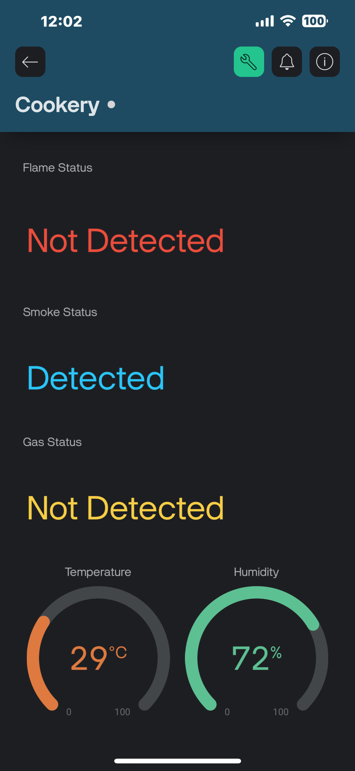
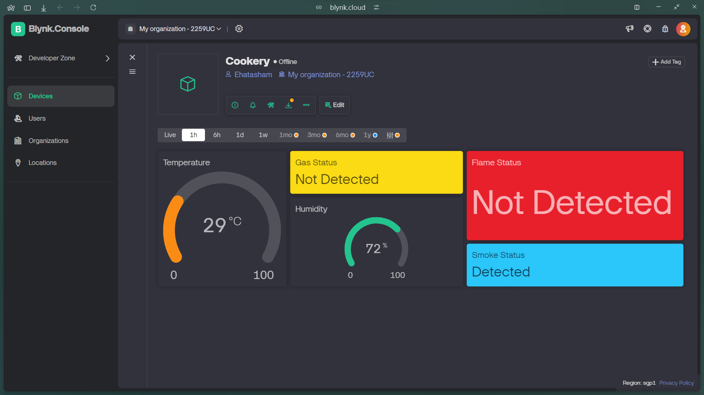
Application
Demonstration

Slide 12
Setbacks
Wiring issues.
Difficulties in calibration.
Sensor failure.
Power supply issues.
Solutions
Casing the problem.
Highest threshold value set.
Newer sensors with higher voltage capacity.
AC/DC adapter replaced batteries.

Slide 13
Budget Cuts

Slide 14
Prospects
Use of rechargeable batteries to make the device portable.
Use of CMOS camera sensor to get live footage of the kitchen.
Shrink the overall footprint of the device to make it more portable.
Build a home server to locally store data or pay a company to do so.

Slide 15


